Slide 1

Rochester Academy of Medicine
IPE/P Consortium
Mission: The Rochester Academy of Medicine advances learning, encourages service, and initiates collaboration in the communities we serve.
Vision: The Rochester Academy of Medicine will lead in fostering solutions that bring better health to our communities.
Values: Collaboration, Integrity, Leadership, Diversity
March 12th, 2020

Slide 2
IPE/P Consortium
Agenda 3/12/2020
Time | Topic | Facilitator
8:00 AM: | Welcome/Introductions/Review of Feb Meeting Minutes | Les
8:15 AM: | IPE/P Best Practice/Tools Sharing | All
8:45 AM: | Ongoing Scope Discussion | All
9:15 AM: | Adding New Members | All
9:30 PM: | Close | Les

Slide 3
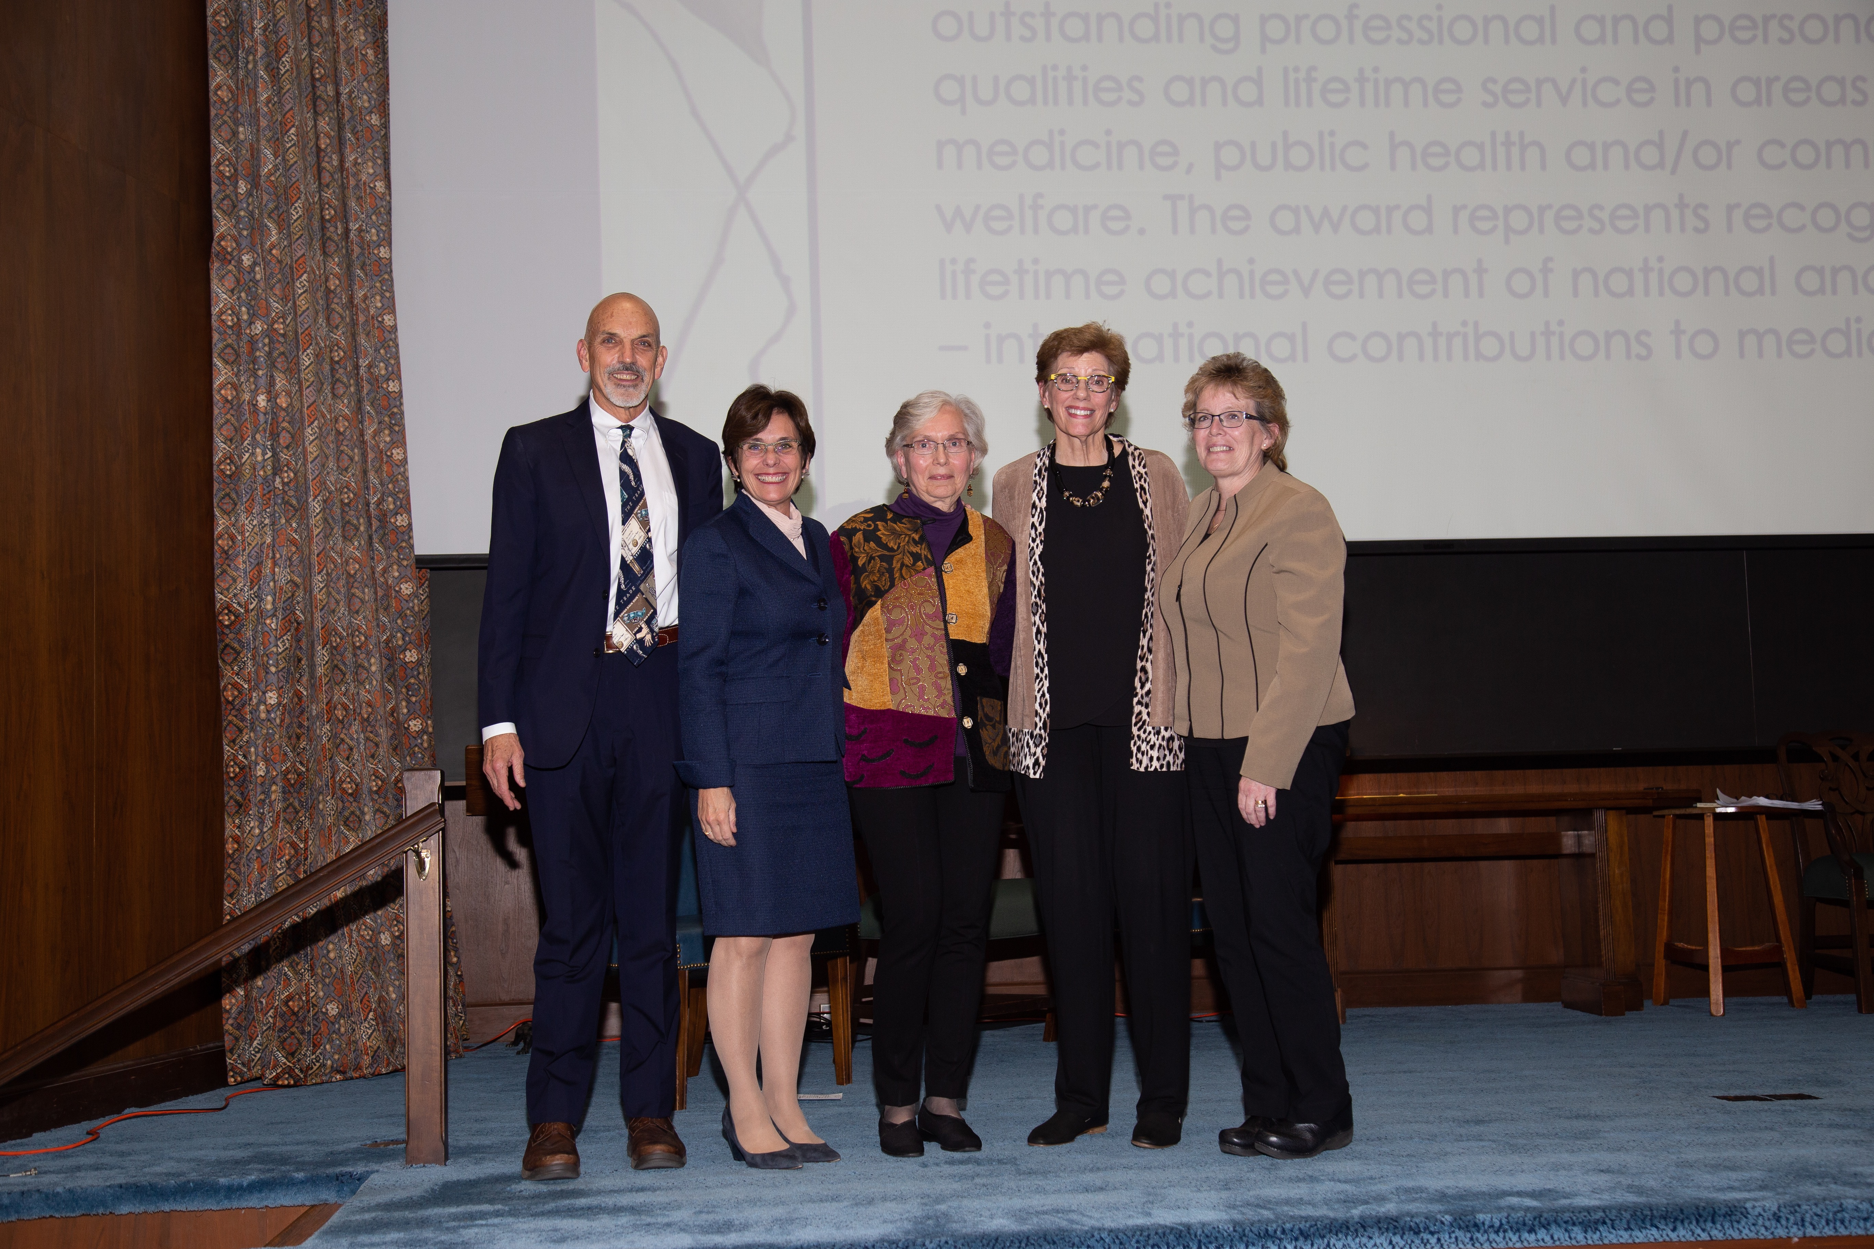
Origin of IPE/PC (still working on a name ☺).
This photo says it all…
Need for improved IPE/P in the community.
Bridging the gap between IPE and IPP.
IPE/P – direction that RAOM is heading.
Newly established IPE Award.
National/International Professionals right in our backyard.

Slide 4
Interprofessional Education Consortium (IPE/PC)
Progress-to-date…
Introductory meeting on 11/14/19 with a small group. (RRH, URMC, Le Moyne, SJF, GRC-CSC, RAOM).
Confirmed the need for such a consortium.
Confirmed the Academy was well-positioned to lead this effort.
Group shared perspectives on the state of IPE and IPP.
Group advanced names of members to join the consortium.
Agreed to survey all group members to gain input on focus, areas of concern, best practices etc. Survey was developed and sent out for review at 2nd meeting.

Slide 5
Interprofessional Education Consortium (IPE/PC)
Progress-to-date…
2nd meeting was held on 2/6/20 with the larger group consisting of educators, community members and practitioners to review the survey questions.
Six questions:
Overall Goal of Consortium?
Focus of the IPEC? Top three?
Number 1 gap between teaching of IPE and clinical practice?
One IPE Best Practice?
Measure success?
How to present our work as we move forward?

Slide 6
Interprofessional Education Consortium (IPE/PC) - Progress-to-date…
Survey High Points – on the way to clarifying the goal (s) for the consortium…
Community health, patient care & linking community need with schools was cited as important.
Assessing what is currently taking place in the community would be useful for scope questions. Develop an inventory of that and IPE/P practices. Delve into reviewing existing models e.g., IP Competencies Model, the IPE Research Model, The Nexus Model & be thinking about what research, in general, should have a place in this work.
Bridging between academia and application resonated with everyone. At which level should we start this work? Focus on collaborative care first and then move on to team-based care?
A few best practices so far: helping students understand their own professional identity as well as other professionals’ roles on a HC team. Providing a strong foundation in IP principles w/many opportunities for authentic IP experiences. Faculty and student experiences that are led/taught/facilitated by faculty from different professions.
How to measure success? That’ll depend on what we are measuring ☺.
How to present our work? Every way possible! Lectures, presentations, publications etc.

Slide 7
Interprofessional Education Consortium (IPE/PC)
Best Practice/Tools - Sharing

Slide 8
Interprofessional Education Consortium (IPE/PC)
Each group member to identify one IPE/P best practice and one IPE/P tool or resource (to begin building an IPE/P inventory) and present that to the group at the next meeting.

Slide 9
Interprofessional Education Consortium (IPE/PC)
Scope Discussions

Slide 10
Interprofessional Education Consortium (IPE/PC) –
IPE/P Consortium contemplating the following questions:
    Focus on collaborative care first then team-based care?
    How to advance IPE/C in the community? This is a big question and leads to big initiatives like a community assessment. Should this be the path?
    Or, how can the RAOM IPE/C be developed as an "incubator" for IPE/C?. Maybe bring speakers, host workshops, sponsor events, have working sessions, get some small grants (to start). "Incubator" might make things more manageable and resonate with many stakeholders - as a starting point.

Slide 11
Interprofessional Education Consortium (IPE/PC)
Membership

Slide 12
Interprofessional Education Consortium (IPEC)
Group Members – to date…

Slide 13
Interprofessional Education Consortium (IPEC)
Group Members – in pursuit…

Slide 14
Interprofessional Education Consortium (IPE/PC)
Next Meeting?

Slide 15

Close

